Slide 1
Ad Campaign
Case Study
Clean the Data
Groups 5, 6, 7
Yulia Khanunov, Susan Lin, Michael Spektor, Jarin Nurin, Sarmistha Das, Ashley Williams, Zhen Li, Sadiqur Sakib, Kamilah Torres, Daniel Lee

Slide 2
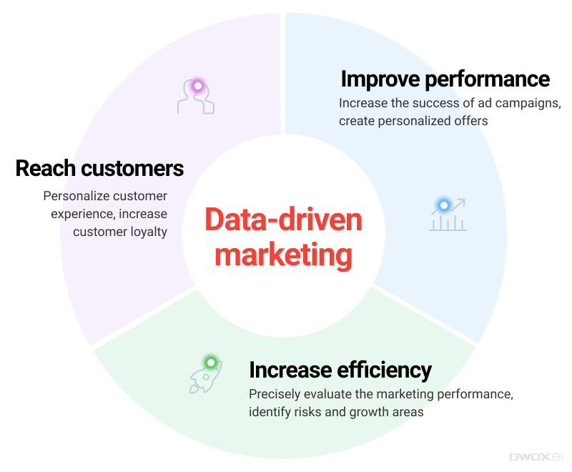
Introduction (Daniel)
A campaign in the social media world is a promotional campaign that a media agency runs on social media networks on behalf of a client.
Types of Marketing Campaigns :
Traditional media
Seasonal push
Product launch
Brand awareness
Rebranding
Brand launch
Contest marketing
Email marketing

Slide 3

What is Cleaning? (Kamilah)
Data Cleaning is the process of detecting, correcting and removing corrupt or inaccurate records from a record set.
It refers to identifying incomplete, incorrect, inaccurate or irrelevant parts of the data and then replacing, modifying, or deleting the dirty or coarse data

Slide 4
How is Cleaning Done? (Susan)
.head() - to get the first few row in the dataframe
.count() - function that returns the number of times an object appears in a list
.duplicated() - help find duplicate value that cause problems and clog up analytics software. Return Series with True and False values
.isnull() - find missing value so we can either drop or input the missing data
.describe() - computes and displays summary statistics for a Python dataframe. This also let us sniff out an outlier by first, pulling up our dataset
.sort() - sorting and changing a list

Slide 5


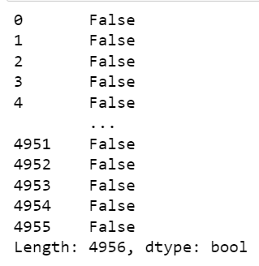
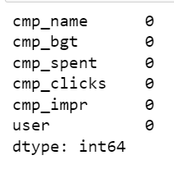
Cleaning the Data Code Snippets (Susan)
Input
Input
Output
Output

Slide 6
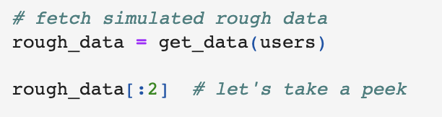
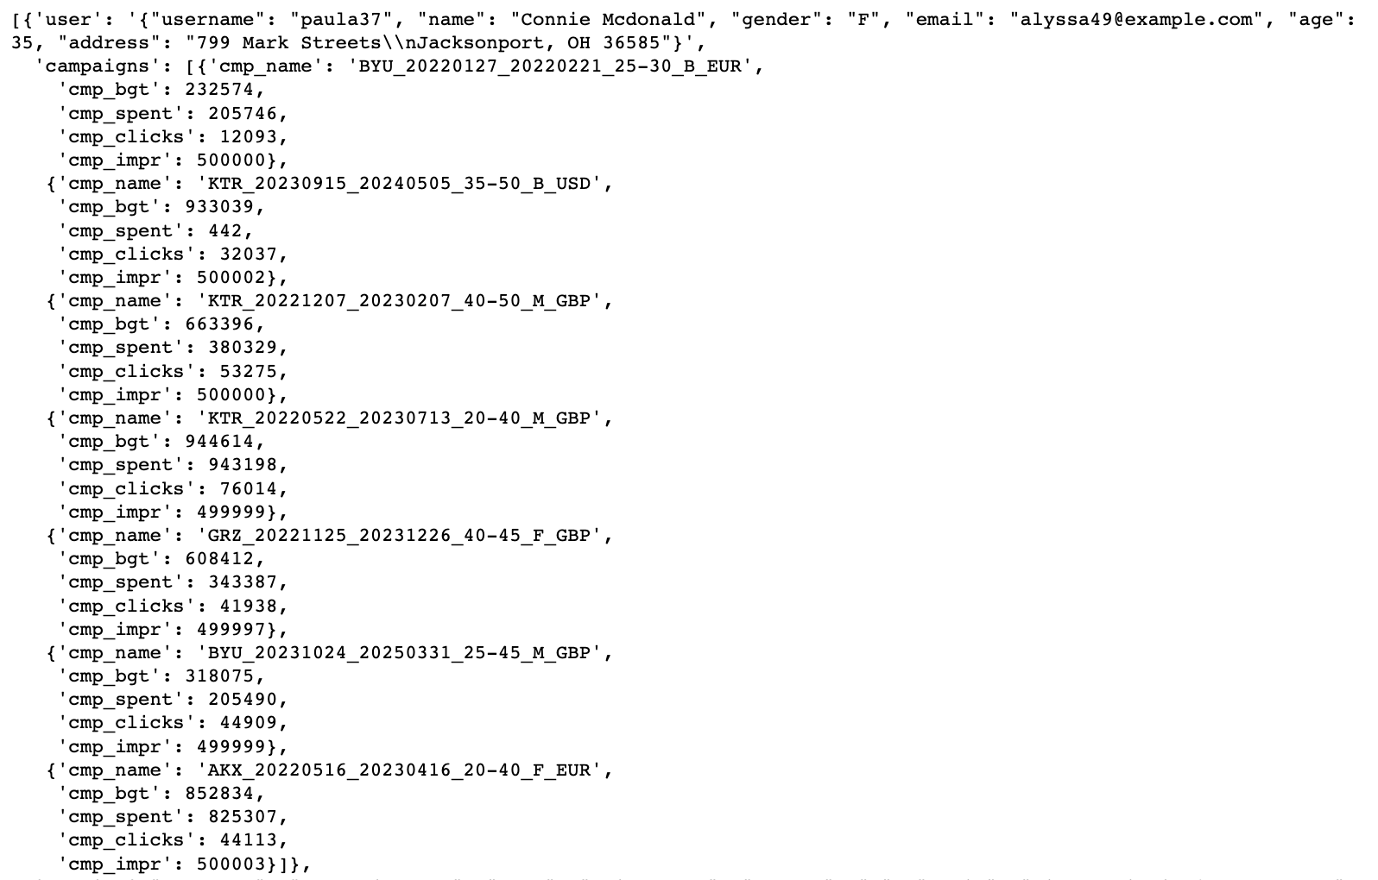
Cleaning the Data (Zhen Li)
Input
Output

Slide 7
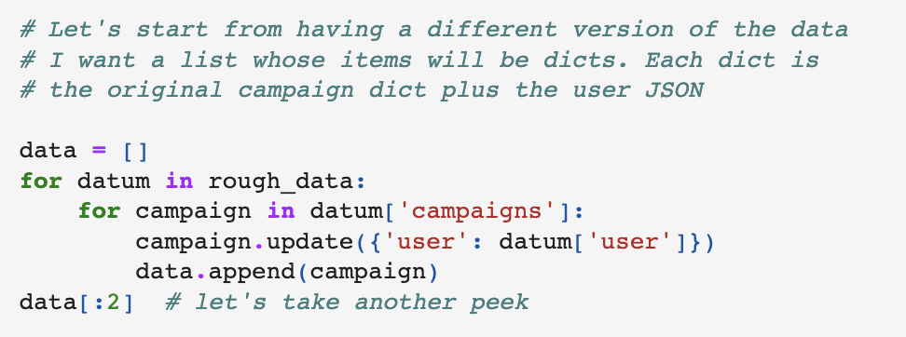
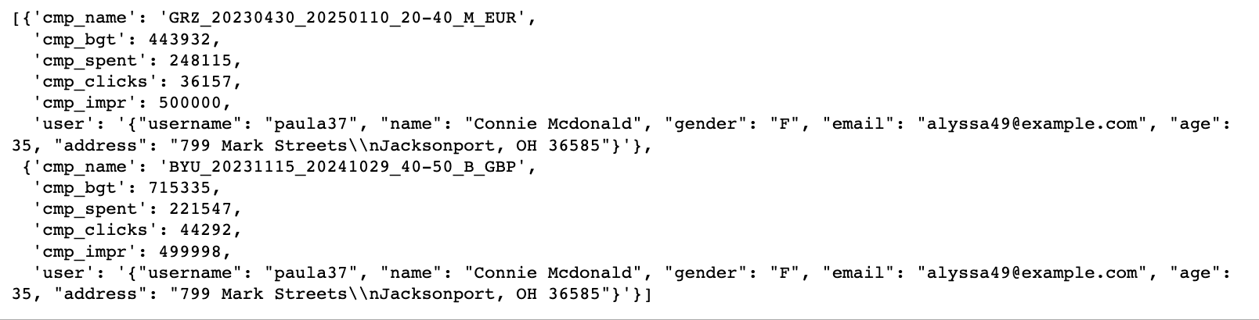
Cleaning the Data (Sadiqur)
Input
Output

Slide 8

What changes do we see after we cleaned compared to before? (Michael)
Before the cleaning
Before cleaning the data all we have is a generated code from the get_data() function. This data is messy and disorganized.
After we cleaned the data, all the information we generated is added to the campaign dictionary using the update() method.
Now the data is organized, we can see that many of the values we had before the cleaning merged and automatically updated the campaign dictionary. The cleaned data is formatted and is ready to be used as a dataframe
After cleaning the data

Slide 9
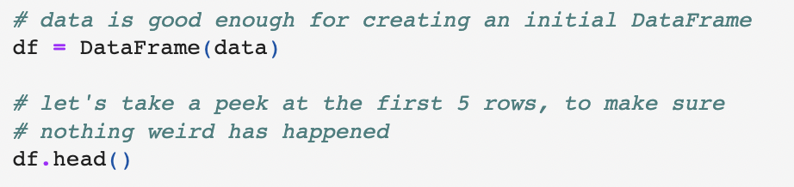
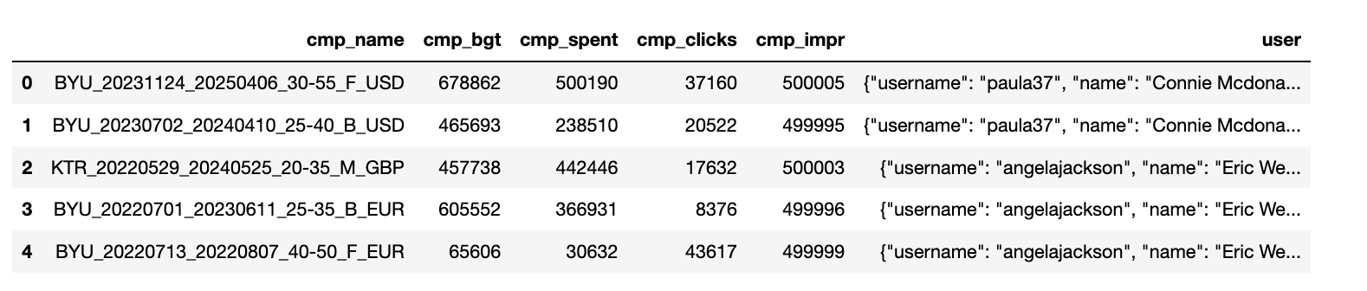
Creating the DataFrame Code Snippets (Sarmistha)
Input
Output

Slide 10
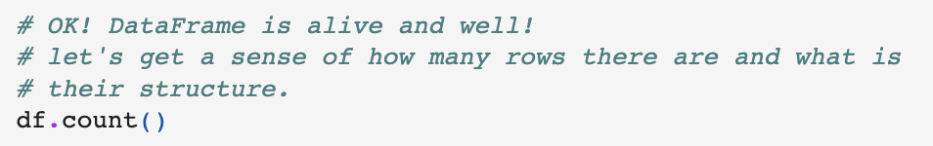

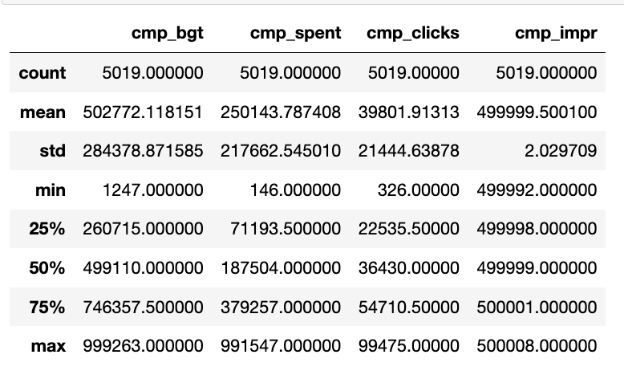
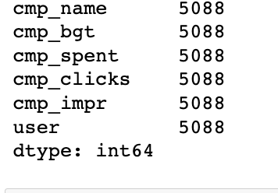
Creating the DataFrame (Ashley)
Input
Input
Output
Output

Slide 11
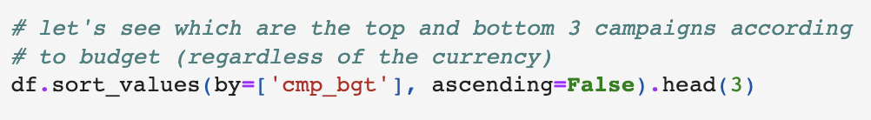
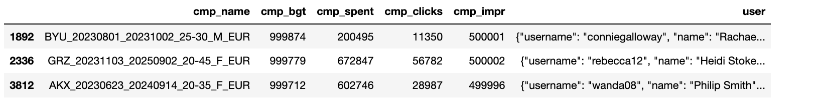
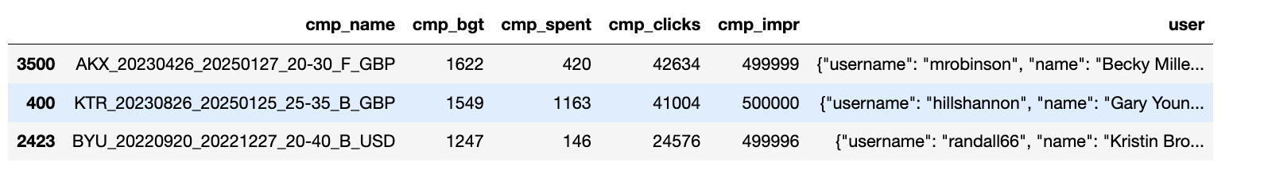
Creating the DataFrame (Jarin)
Input
Output
Input
Output

Slide 12

Conclusion (Yulia)
Marketers use data analytics to recognize the ad campaign patterns, and to conclude how the campaign has impacted consumer behavior, sales, and interest in a certain product.
Cleaning the data is crucial step in data analytics. Without cleaning the data reports resulted from the uncleaned data will be inaccurate and false.
The changes that can be seen is before the data is messy and disorganized, to being formatted and ready to use in a dataframe.
Cleaning codes used but not limited to:
.duplicated()
.isnull()
.describe()
With organized data creating the dataframe
is the next step, following by manipulating
the data.

Slide 13
Questions?

